Slide 1
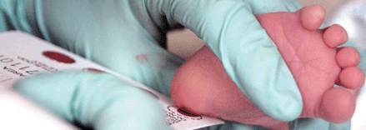
NBS for Galactosemia by LCMSMS
Hilde Laeremans, PhD
Hong Vien Van Thi, Ir
Prof. Philippe Goyens, MD, PhD
ABSCIEX

Slide 2
Galactosemia: the disease
Phenotypic characteristics vary widely according to the defective enzyme
Autosomal recessive
Prevalence: 1/30.000-60.000
Single enzyme defect
Caused by deficiency of one of the following enzymes:
Galactose-1-phosphate uridyl transferase (GALT)
Uridine diphosphate (UDP)-galactose-4-epimersae (GALE)
Galactokinase (GALK)
Classic and mild galactosemia (Duarte variant)
( Jensen UG 2001, Ko DH 2010 and Ko DH 2011)
Notes:
Duarte variant = GALT

Slide 3
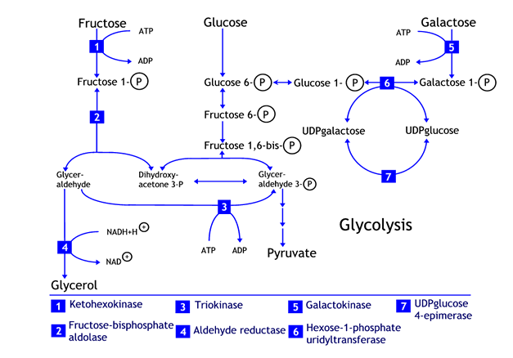
Galactosemia: the pathway
Notes:
7= GALE
6= GALT
5= GALK

Slide 4
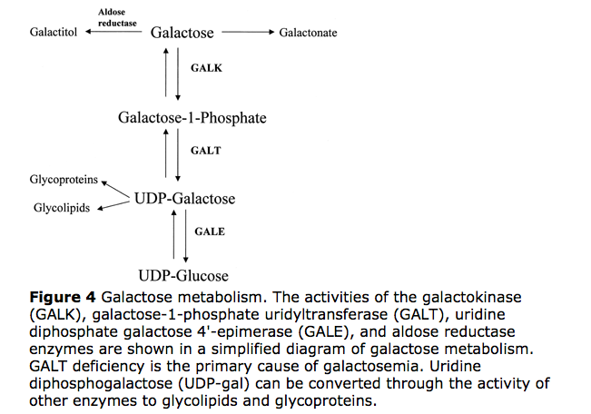
Galactosemia: the pathway

Slide 5
Galactosemia: the disease
A) Classic (GALT-GALE)
Deficiencies in the enzyme cause:
Accumulation of galactose in the blood and urine
High intracellular levels of galactose-1-phosphate
Toxic for several tissues (liver, brain and renal tubules)
Described by Von Reuss as early as 1908
Clinical symptoms:
Failure to thrive
Vomiting
Diarrhea
Jaundice
Lethargy
( Jensen UG 2001, Ko DH 2010 and Ko DH 2011)

Slide 6
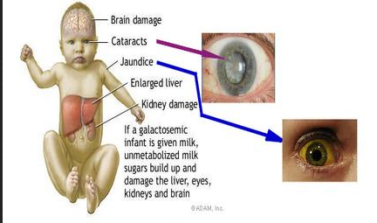
Galactosemia: the disease

Slide 7
Galactosemia: treatment
Lactose and galactose-free diet
Special lactose-free formula
Calcium supplements: calcium intake may be low due to absence of milk products in the diet
Galactokinase inhibitors
Medic-alert bracelets
Monitoring health:
Regular blood and urine tests
Evaluation of mental development
Evaluation of language skills
(Wierenga KJ 2008)

Slide 8
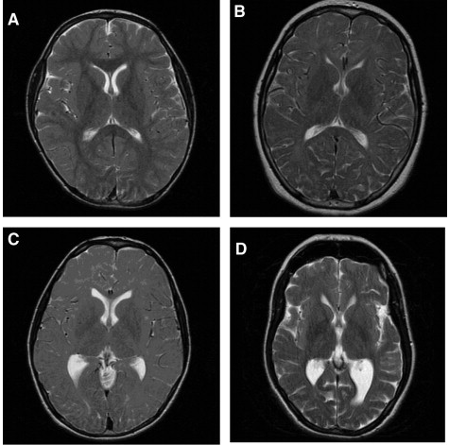
Galactosemia: long term complications
Speech and learning difficulties
Behavior
Ovarian failure
Ataxia and tremor
MRI abnormalities
Osteopenia
Growth may be delayed
Only recent years have we come to appreciate persistent complications in treated galactosemics
(Hughes 2008, Kaufman 1993 and Steiner RD 2012)

Slide 9
Galactosemia: the disease
B) Mild (GALK)
-
- Clinical symptoms:
Early and severe cataracts
Mild mental retardation
Ataxia
Delays in growth
Speech problems or delays
( Jensen UG 2001, Ko DH 2010 and Ko DH 2011)
Notes:
Na tijd is de katarakt fomatie irreversibel

Slide 10
Galactosemia: the tests and their pitfalls
1. Paigen test:
Microbiologic test using E. coli or E. coli in combination with a bacteriophage to test for elevated blood galactose content (only positive after milk ingestion)
Measurement of galactose accumulation
Qualitative method and relies on visual interpretation
Pitfalls: use of antibiotics (false positive - high recall rate)
(Fujimoto A 2000)
Notes:
Indien alkaline phospahtase wordt toegevoegd zodat galactose fosfaat wordt gehydrolyseerd kan GALK ook worden gedetecteerd

Slide 11
Galactosemia: the tests and their pitfalls
2. Beutler test:
Developed in 1966
Qualitative and relies on visual interpretation
→ methylene blue
Assessment of GALT activity
Takes into consideration: humidity, duration between sampling and testing, and anemia
This test has been modified and improved:
NADPH fluorescence (Beutler enzyme spot test)
Quantitative method with fluorescence detector
Influence of quenching by hemoglobin prevented by acetone and methanol
Pitfalls: heat inactivation, transfusion and G6PD deficiency, carriers, variants and early tests
(Beutler 1966 and Fujimoto A. 2000)

Slide 12
Galactosemia: the tests and their pitfalls
3. Hill test:
fluorometric assay for galactose, normally used with Beutler, only positive after milk ingestion
Measures accumulation of galactose
Pitfalls: beware of non-lactose diet, carriers, variants and early test
(Steiner MD 2012)

Slide 13
Galactosemia: Test with LCMSMS
1. UPLC-MSMS
Method in negative mode with high strength silica T3 column
Scan for activity of the three known enzymes (GALT, GALE and GALK)
Before adjustment to hemoglobin concentrations relative high inter-assay imprecisions
Pitfall: high coast in comparison to ‘traditional’ screening (10 dollar)
→ Better suited for second-tier testing
(Ko DH 2010)

Slide 14
Galactosemia: Test with LCMSMS
Test method can be adapted for ‘regular’ LCMSMS with suitable column
Use short column to reduce time
All types of galactosemia can be detected
(Ko DH 2010)

Slide 15
Galactosemia: Test with LCMSMS
2. Liquid/gas chromatography-tandem mass spectronomy
Stable isotope detection: (¹³C₆)-Gal-1-P, (¹³C₆)-Glu-1-P en (¹³C₆)-UDPGal
Simplifies reagent requirements
More specific than classical assays due to high resolution
Hetero- and homozygotes are detectable and can be distinguished
Pitfall: erythrocytes have to be lysed→ not visible on dried blood spots
Can be used for test on urine
( Li Y 2010, Chen J 2002, Gangemi G 2012 and Ko DH 2010)

Slide 16
Galactosemia: Test with LCMSMS
Neonatal screening on DBS
Test on filter paper days 4-8 days after sampling
Test can be performed even 10 years after sampling when stored at -20°C
Total hexose monophosphates were used as markers of Gal-1-P
Sample preparation:
150μl of extraction liquid
Evaporation under stream of nitrogen gas
Redissolved in water-acetonitril (1:1)
(Jensen 2001)
Notes:
Extraction liquid: acetronitril-water, methanol-water best acetonitril-water (1:1)

Slide 17
Galactosemia: Test with LCMSMS
MSMS:
Negative ion mode electro-spray
Mobile phase: acetonitril-water (1:1)
Sample-to-sample cycle time 1,5 min
m/z transitions: 259→97 and 259→79
Detection limit of 1mmol/L
Sensitivity and specificity of 100%
Sensitive to heat and humidity → false positives
Internal standards: peripheral blood enriched with Gal-1-P
Able to detect galactose-4-epimerase deficiency
(Jensen 2001)

Slide 18
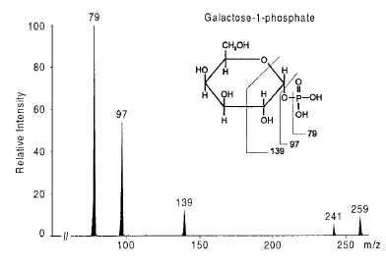
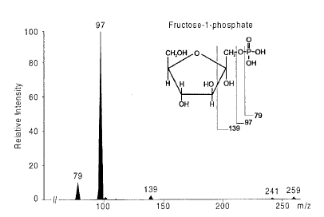
Galactosemia: Test with LCMSMS

Slide 19
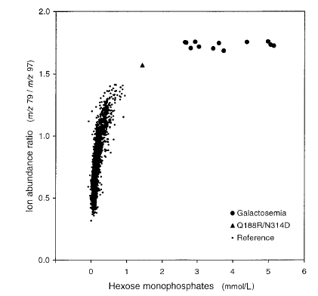
Galactosemia: Test with LCMSMS

Slide 20
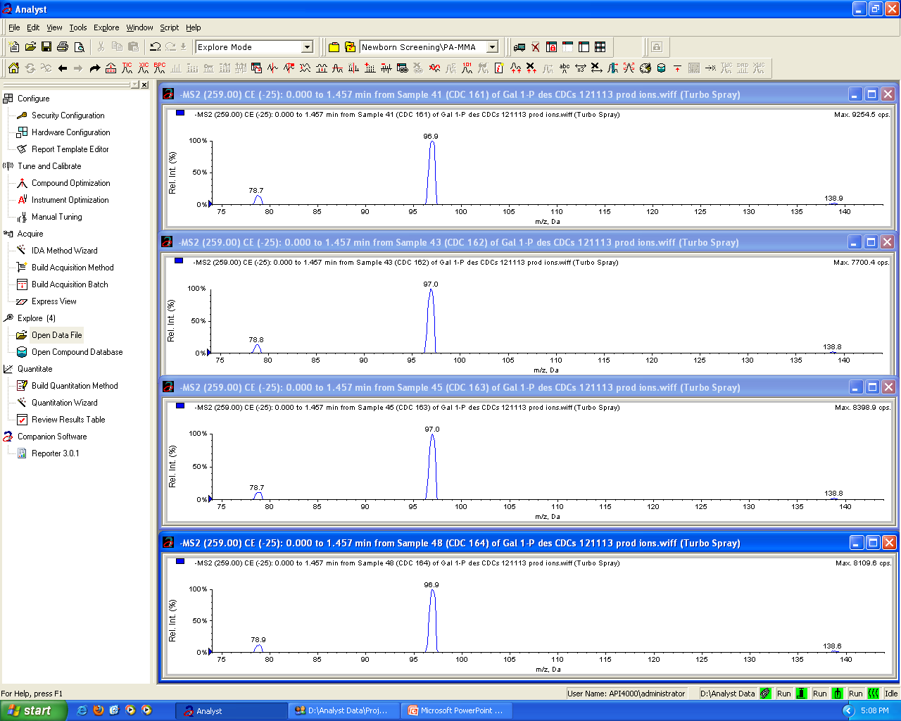
Galactosemia: Test with LCMSMS

Slide 21
Galactosemia: Test with LCMSMS
Gal-1-P
Fruc-1-P

Slide 22
Conclusions
Many test are available but every test has his pitfalls
Easy and fast testing for classic galactosemia without column
Other types of galactosemia can be tested with a short column LC/MSMS method
Short time
More specific
Relative low cost

Slide 24
Galactosemia: the tests
Tests include:
Blood culture for bacteria infection (E. coli sepsis)
Enzyme activity in the red blood cells
Galactidol in the urine
Prenatal diagnosis by directly measuring the enzyme galactose-1-phosphate uridyl transferase
Erythrocyte galactose-1-phosphate measurement by GC-MS
Breath test
Tubular function
(Pubmed Health 2011)

Slide 25
Galactosemia: the tests and their pitfalls
Florida test:
A simplified ‘breath’ test
Quantification of body oxidation of ¹³C D-galactose to ¹³CO₂
Increase of TBGO to CO₂
Less than 2% of ¹³C = galactosemia
Age specific normal data
No blood is necessary
Can be performed by nurse before baby leaves
Pitfalls: gas isotope ratio mass spectrometer is expensive and alternative technologies are low in sensitivity
(Barbouth DS 2007)

